Slide 1
Student Dropout Prediction
Using Supervised Machine Learning Classifiers
Dataset: Student's Dropout Dataset • 4,424 Records • 35 Features

Slide 2
Agenda
01
About the Dataset
05
Hyperparameter Tuning
02
Exploratory Data Analysis (EDA)
06
Model Performance & Best Model
03
Data Preparation & Feature Engineering
07
Evaluation Metrics
04
Models Selected
08
Conclusions & Improvements

Slide 3
About the Dataset
DATA OVERVIEW
4,424
35
3
0
Total Records
Features
Target Classes
Missing Values
Target Variable: Dropout | Graduate | Enrolled
Demographics
Academic Background
Age, Gender, Marital Status, Nationality, International
Previous qualification, Application mode/order, Course
Financial Status
Academic Performance
Debtor, Scholarship holder, Tuition fees up to date
Curricular units (1st & 2nd sem): credited, enrolled, approved, grade
Socioeconomic
Parents Info
Unemployment rate, Inflation rate, GDP (dropped after EDA)
Mother's & Father's qualification & occupation

Slide 4
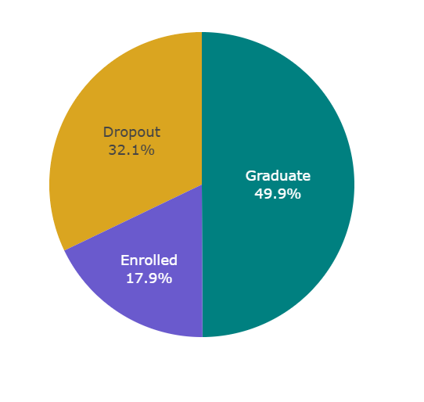
EDA — Target Distribution
TARGET VARIABLE
Key Observations
49.9% students Graduated — majority class
32.1% students Dropped Out — significant concern
17.9% students are currently Enrolled

Slide 5
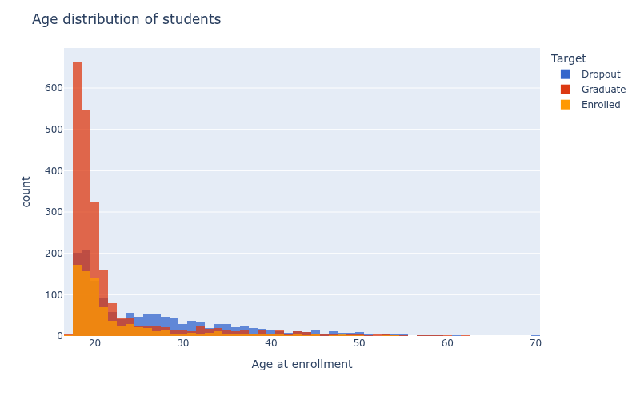
EDA — Age Distribution & Gender Analysis
[ INSERT: Age Distribution Histogram from Notebook ]
Age Distribution of Students by Target Status
Age: Right-skewed
Majority in late teens to early 20s. Dropout increases for students aged 25–35.
Gender: 64.8% Female, 35.2% Male. Male dropout rate (45.1%) is significantly higher than Female (25.1%)

Slide 6
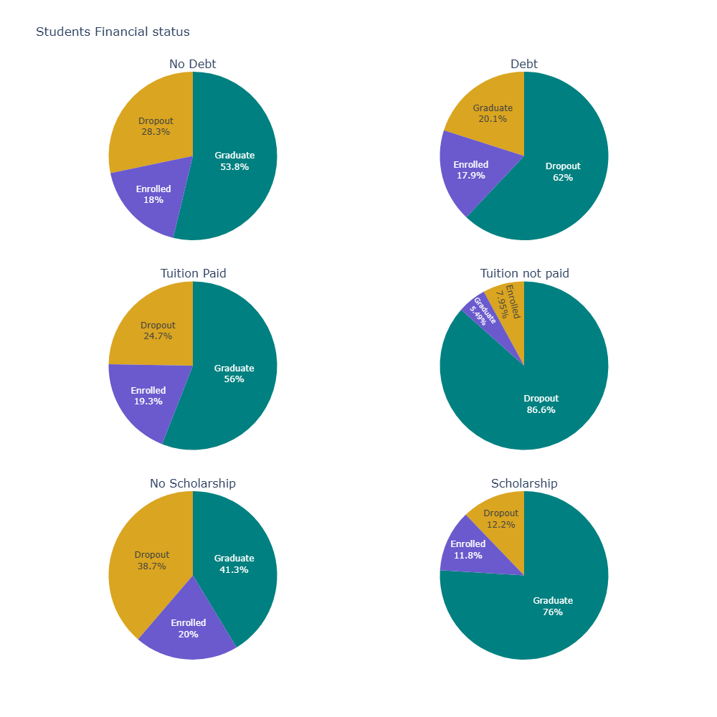
EDA — Financial Status & Courses
[ INSERT: Financial Status Pie Charts from Notebook
(Debt / Tuition / Scholarship) ]
86.6%
dropout if tuition NOT paid
62.0%
dropout if in debt
38.7%
dropout without scholarship
12.2%
dropout WITH scholarship
Top Courses: Nursing had the most students & lowest dropout (15.4%).
Highest Dropout: Biofuel Production Technologies (66.7%) and Equiniculture (55.3%)

Slide 7
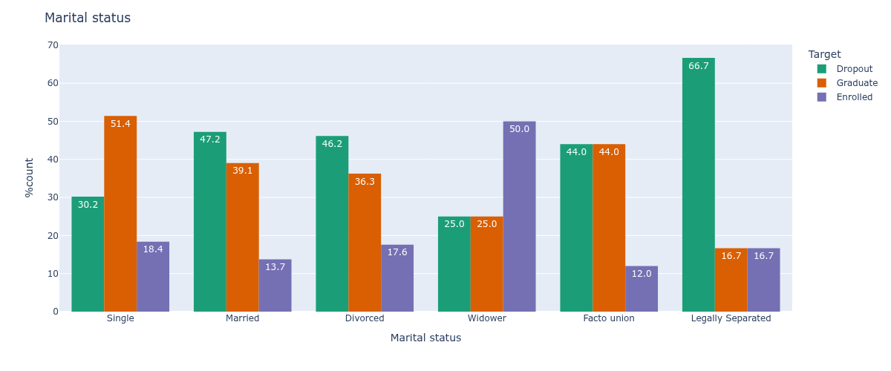
EDA — Marital Status
[ INSERT: Marital Status Distribution Charts from Notebook ]
Single students
Legally Separated
Married students
Majority of students; 30.2% dropout rate
Highest dropout rate at 66.7%
Second highest dropout rate at 47.2%

Slide 8
Data Preparation & Feature Engineering
1
Correlation
Analysis
2
PCA
Heatmap to find highly correlated feature pairs
12 curricular unit columns → 1 PCA component
3
Feature
Dropping
4
Target
Encoding
Dropped 18 correlated/redundant features
Dropout = 1, Graduate/Enrolled = 0 (binary)
5
Standardization
6
Train/Val/Test
Split
StandardScaler on all features (zero mean, unit var)
80% Train → 80/20 split → Train/Val, 20% Test

Slide 9
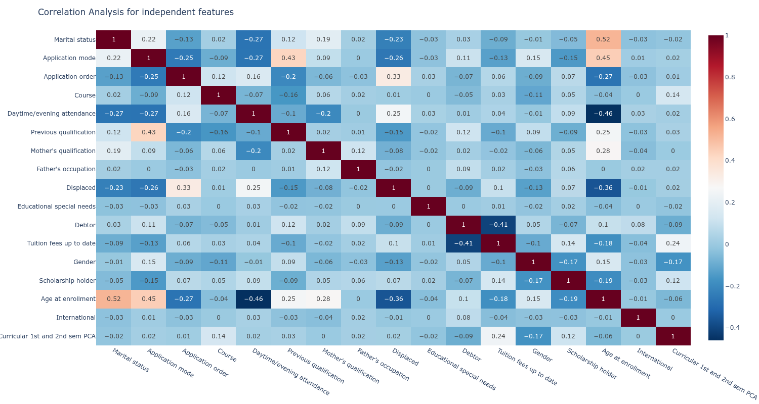
Principal Component Analysis (PCA)
DIMENSIONALITY REDUCTION
[ INSERT: Correlation Heatmap from Notebook ]
Input Features
12 Curricular Unit columns (1st & 2nd semester: credited, enrolled, evaluations, approved, grade, w/o evaluations)
PCA Output
1 Principal Component capturing maximum variance
Why PCA?
Curricular unit features were highly correlated. PCA compresses without losing critical academic performance info
Other Dropped
Nationality, Mother's occupation, Father's qualification, Inflation rate, GDP, Unemployment rate
Final Feature Count: 35 features → reduced to 17 features after PCA + dropping correlated columns

Slide 10
Models Selected
5 CLASSIFIERS
LR
DT
SVM
RF
KNN
Logistic Regression
Decision Tree
Support Vector Machine
Random Forest
K-Nearest Neighbors
Linear model estimating dropout probability. Interpretable; good baseline.
Tree-based splits with depth tuning via learning curve.
Finds optimal hyperplane. Kernel tested: linear, poly, rbf, sigmoid.
Ensemble of 100 trees. Tuned via GridSearchCV.
Distance-based classifier. k tuned via GridSearchCV + elbow method.

Slide 11
Hyperparameter Tuning
Decision Tree
SVM
Method: Learning Curve
Method: Kernel Iteration
Parameters: max_depth: 1 → 20
Parameters: Kernels: linear, poly, rbf, sigmoid
Best depth selected by max validation accuracy
Best kernel by validation score (linear performed best)
Random Forest
KNN
Method: GridSearchCV (5-fold)
Method: GridSearchCV
Parameters: n_estimators: [25,50,75,100]
max_features: [sqrt, log2, None]
max_depth: [3,6,9]
max_leaf_nodes: [3,6,9]
Parameters: n_neighbors: 1 → 24
Best params from grid search applied
Best k selected by highest validation accuracy (~12–17 range)

Slide 12
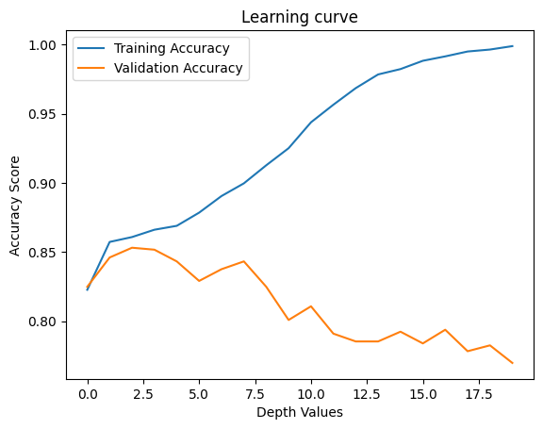
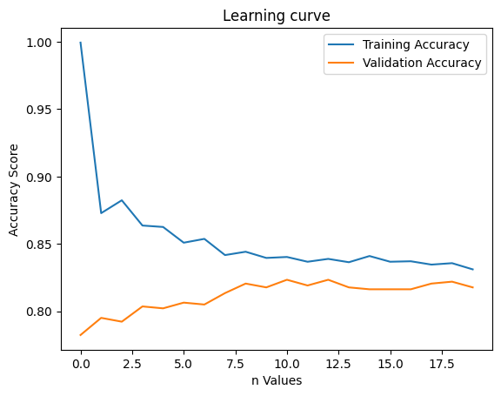
Learning Curves — Decision Tree & KNN
[ INSERT: Decision Tree Learning Curve from Notebook
(Training vs Validation Accuracy by Depth) ]
[ INSERT: KNN Learning Curve from Notebook
(Training vs Validation Accuracy by K) ]
Decision Tree: Best Depth (3)
KNN: Best K value (12–17 range)
Both curves show diminishing returns beyond a threshold — tuning prevents overfitting while maximizing generalization.

Slide 13
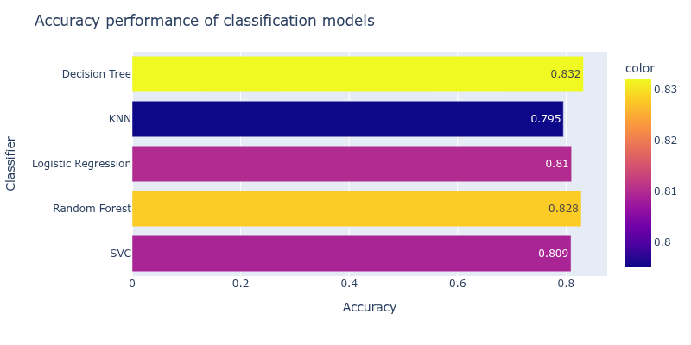
Model Performance Comparison
TEST SET ACCURACY
🥇
SVC
🥈
Random Forest
Strong Ensemble
🥉
Logistic Reg
Solid Baseline
* Exact values depend on your run. Insert your actual accuracy bar chart from notebook here:
Baseline Accuracy
~49% (majority class)
[ INSERT: Accuracy Bar Chart from Notebook ]

Slide 14
Best Model
Decision Tree Classifier
max_depth=3
~83.2%
0.78
Test Accuracy
AUC Score

Slide 15
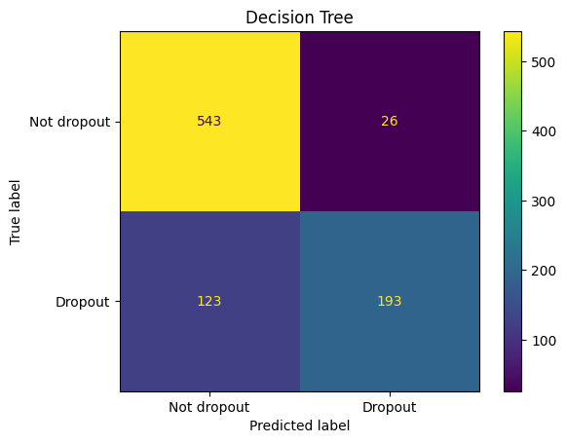
Confusion Matrix : Best Model (Decision Tree)
[ INSERT: Confusion Matrix of Best Model (SVC) from Notebook ]
Confusion Matrix Explained
True Positive (TP)
Correctly predicted as Dropout
True Negative (TN)
Correctly predicted as Not Dropout
False Positive (FP)
Predicted Dropout but actually Not (Type I Error)
False Negative (FN)
Predicted Not Dropout but actually Dropout (Type II Error)
For student dropout: False Negatives are critical — missing a student at risk of dropping out has real consequences.

Slide 16
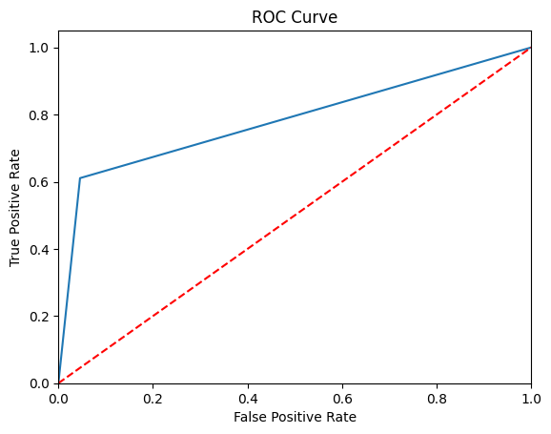
ROC Curve & AUC Score
[ INSERT: ROC Curve from Notebook ]
0.78
AUC Score
AUC Interpretation
0.50 Random (no skill)
0.70–0.80 Good Performance ✓
0.80–0.90 Very Good
0.90–1.00 Excellent
AUC of 0.78 confirms good classification performance — the model correctly distinguishes dropout vs non-dropout 78% of the time.

Slide 17
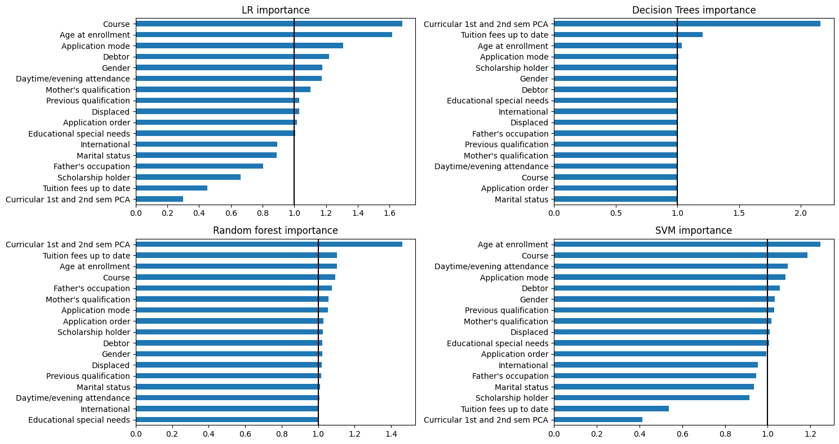
Feature Importance
[ INSERT: Feature Importance 2x2 subplot from Notebook
(LR, Decision Tree, Random Forest, SVM importance) ]
Top Predictors: "Course" and "Age at Enrollment" consistently scored > 1 across LR, SVM, RF, and Decision Tree models, confirming these as some of the strongest dropout indicators.

Slide 18
Evaluation Metrics Used
Accuracy
Confusion Matrix
Formula: (TP + TN) / Total
Formula: TP, TN, FP, FN
Overall correctness of predictions. Primary metric used to compare models.
Visualizes classification performance showing correct and incorrect predictions per class.
ROC Curve
AUC Score
Formula: TPR vs FPR at various thresholds
Formula: Area Under the ROC Curve
Shows trade-off between True Positive Rate and False Positive Rate across thresholds.
Single number summarizing ROC curve. AUC = 0.78 for best model (Good performance).
Baseline Accuracy
Feature Importance
Formula: Max class frequency / Total
Formula: Coef / Gini impurity reduction
Minimum benchmark to beat. Set by majority class (Graduate = ~49%).
Measures each feature's contribution. Evaluated for LR, DT, RF, and SVM (linear).

Slide 19
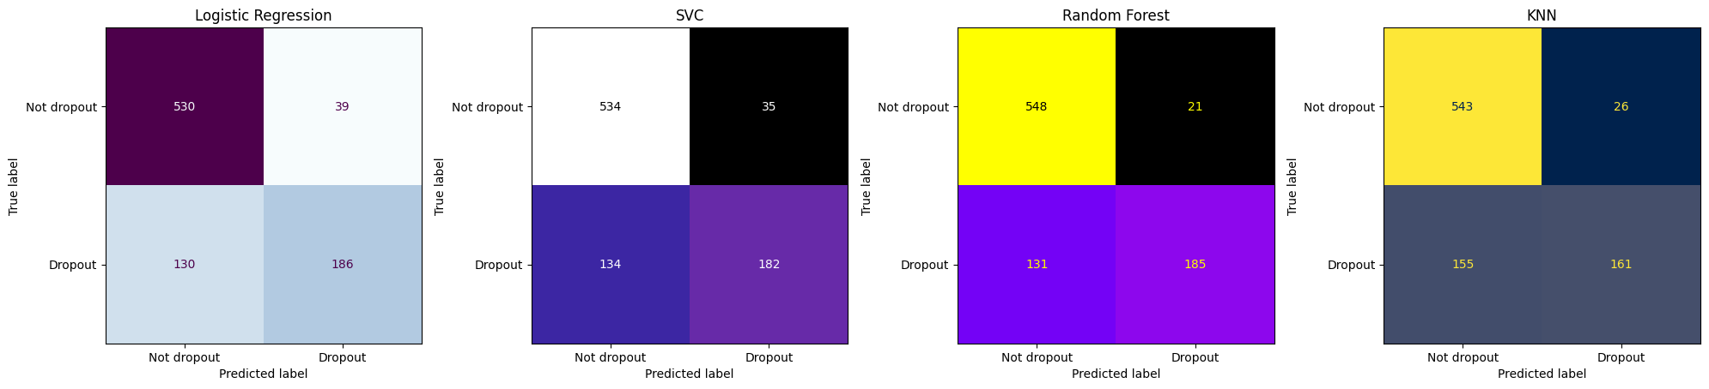
Confusion Matrices — All Models
[ INSERT: 1x4 Confusion Matrix subplot for
Logistic Regression, Decision Tree, Random Forest, KNN
from Notebook ]

Slide 20
Conclusions
KEY FINDINGS
Best Model:
Decision tree achieved the highest accuracy (~83.2%) and AUC of 0.78 — good classification performance.
Key Predictors:
"Course" and "Age at Enrollment" are the most impactful features across all models, indicating academic pathway and student age are critical dropout risk factors.
Financial Factors:
Students with unpaid tuition (86.6% dropout rate) or debt (62%) are most at risk — financial support programs could dramatically reduce dropout.
Gender Disparity:
Male students have significantly higher dropout rates (45.1%) vs females (25.1%) — targeted interventions for male students may be warranted.
All Models Beat Baseline:
All 5 classifiers surpassed the 49% baseline accuracy, with SVC outperforming all others on the test set.

Slide 21
Future Improvements
AREAS TO EXPLORE
Handle Class Imbalance
Advanced Models
Apply SMOTE or class weighting to address the imbalance between Dropout (32%), Graduate (49%), and Enrolled (17%) classes. This can improve recall for minority classes.
Experiment with gradient boosting methods like XGBoost, LightGBM, or CatBoost which often outperform traditional classifiers on tabular data.
Multi-class Classification
Feature Engineering
Currently binary (Dropout vs rest). A 3-class model (Dropout / Graduate / Enrolled) could provide richer insights for interventions.
Create interaction features (e.g., tuition × scholarship), or time-based features from semester performance trends.
Additional Metrics
Deployment
Report Precision, Recall, and F1-score per class — especially important given class imbalance and the high cost of False Negatives.
Package the best model as a REST API or dashboard where educators can input student data and receive dropout risk scores in real-time.

Slide 22
Thank You!
Student Dropout Prediction using Supervised ML Classifiers
Questions & Discussion

